Slide 1
Hangman Game
Group 2
PROJECT BY:
Abhinav Yadav
Varenya Girish Hegde
Yashvardhan Shukla

Slide 2
Previous status:
The screen is shows the title of game HANGMAN.
The background image displaying a board with hangman written in it, which we have created using Canva.
Two buttons are created on the opening screen of the game assigned START and EXIT.
Running of base game graphics after clicking start button.
Keys on the screen giving actual output on mouse click.
Hangman character popping up on the display.

Slide 3
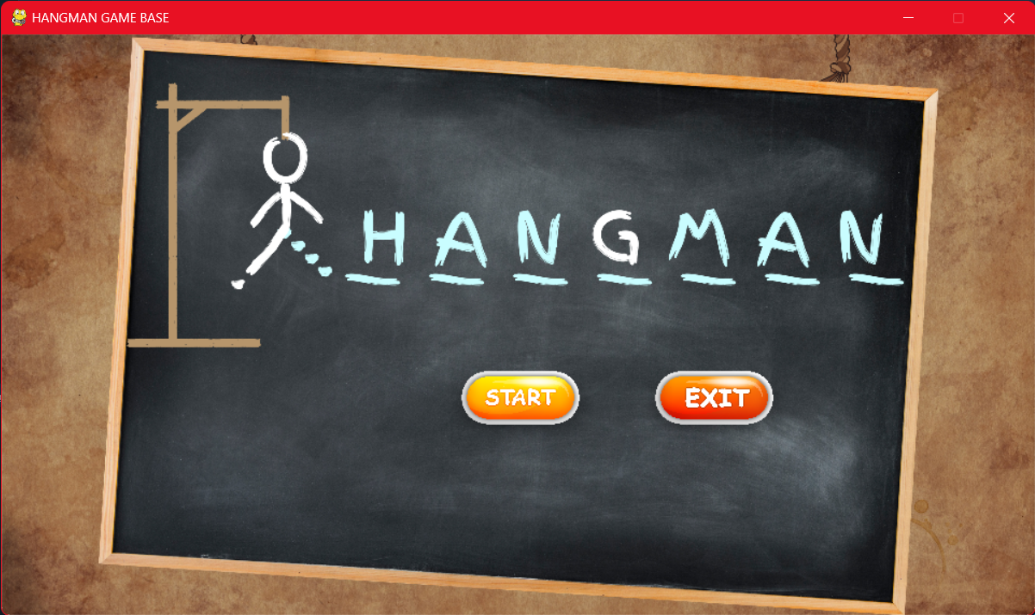
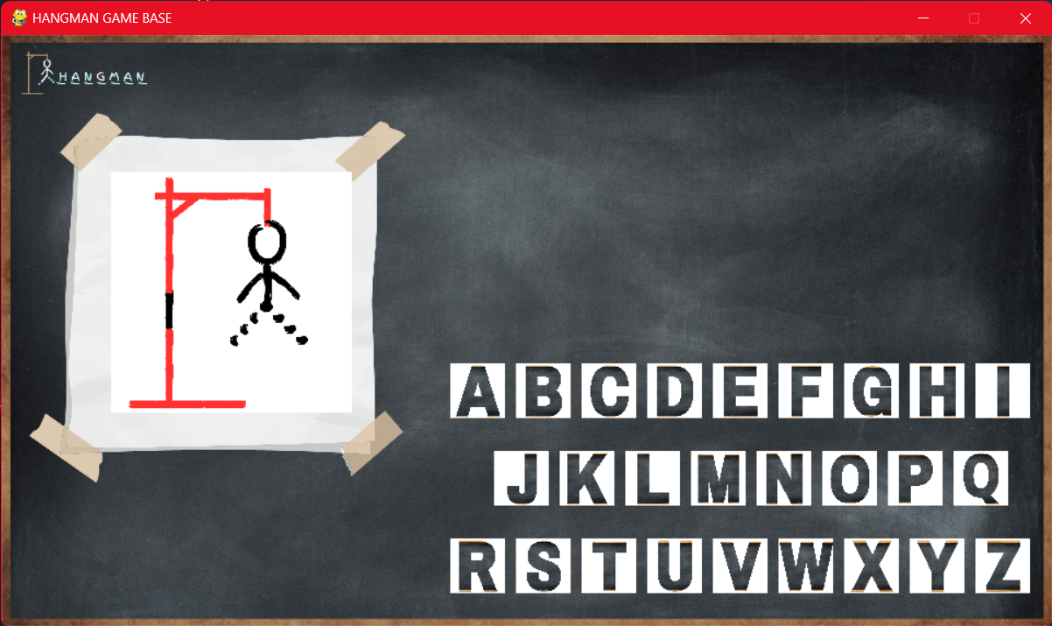
Previous status output
STARTING PAGE
MAIN GAME PAGE

Slide 4
Present status
Animation on running of code showing HANGMAN.
Level 1 game.
Hint displayed in Hindi language to guess the word.
Score and Lives are displayed on top right corner.
Aphabet keys giving outputs.
Restart and Quit button popup after loosing.

Slide 5
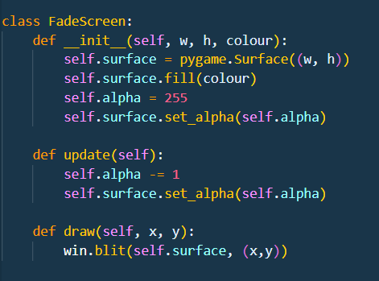
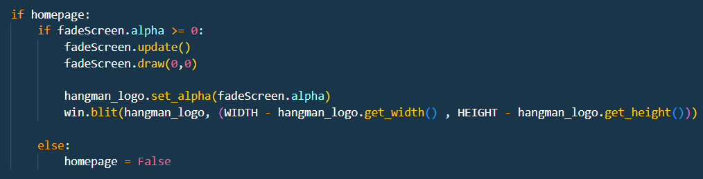
Current status output:

Slide 6
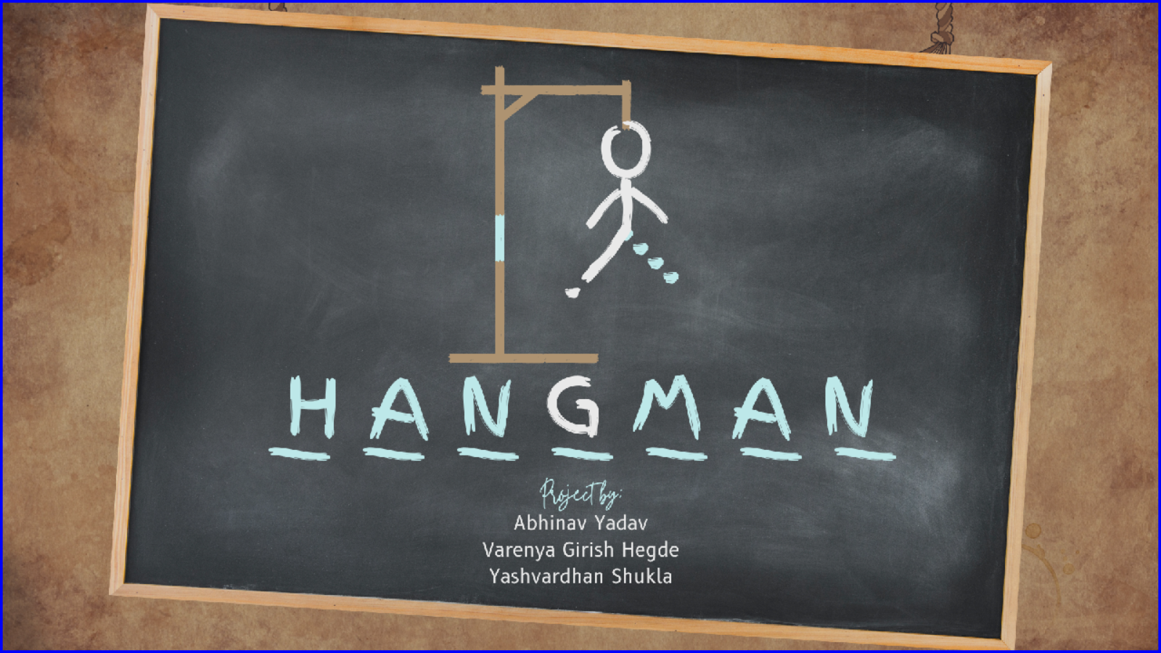

Slide 7
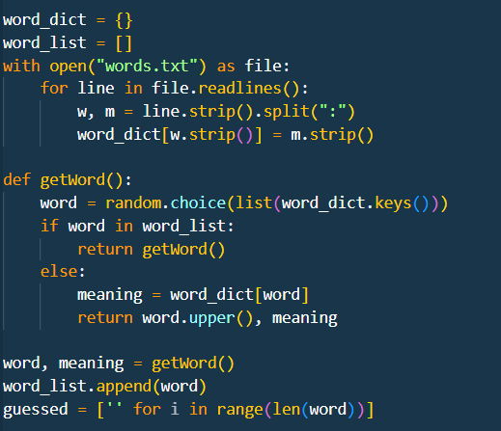

Slide 8
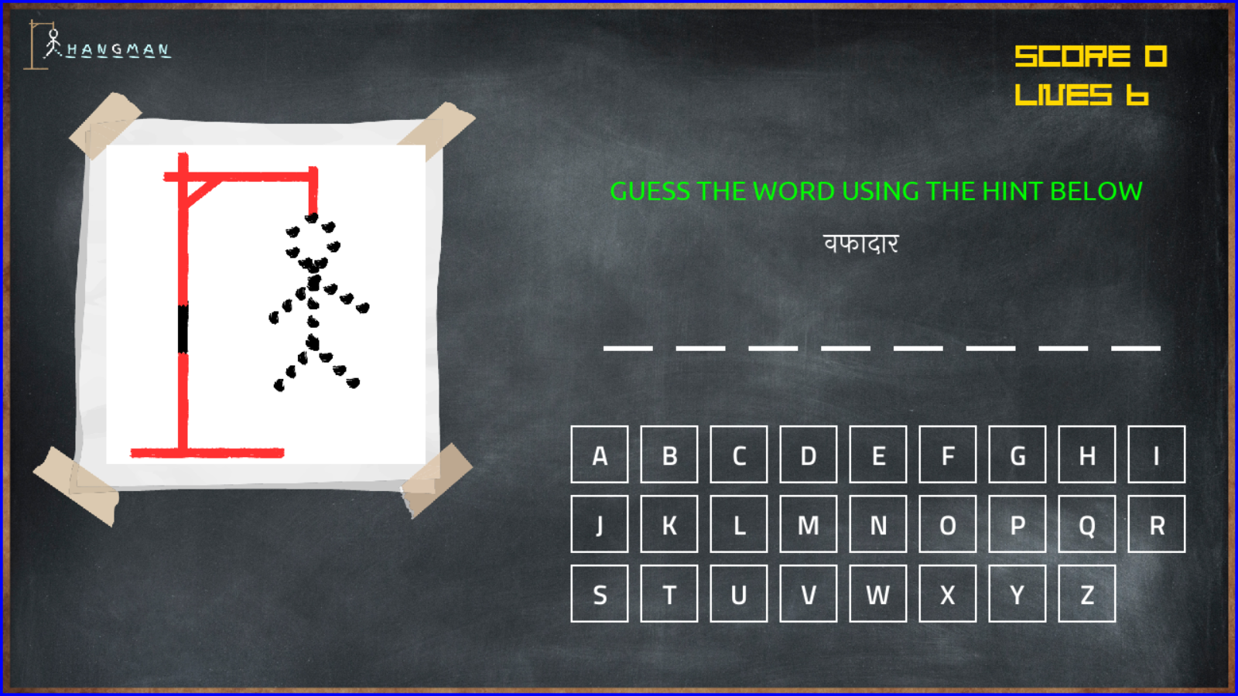

Slide 9
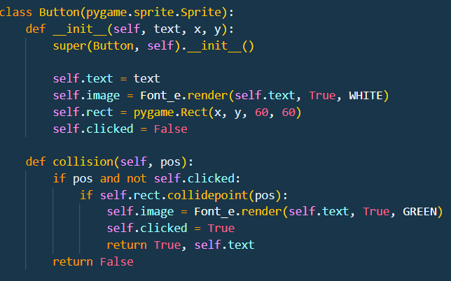

Slide 10
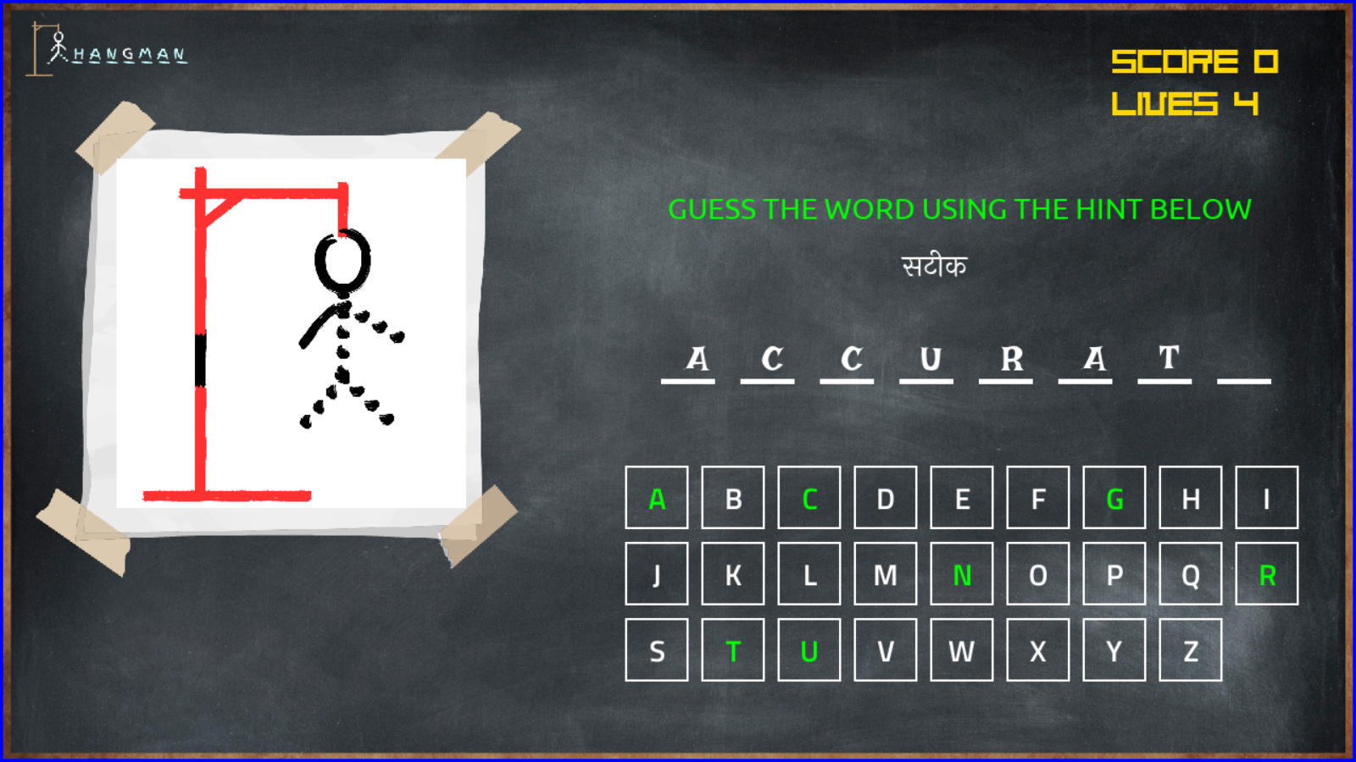

Slide 11
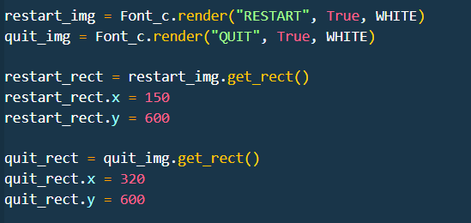
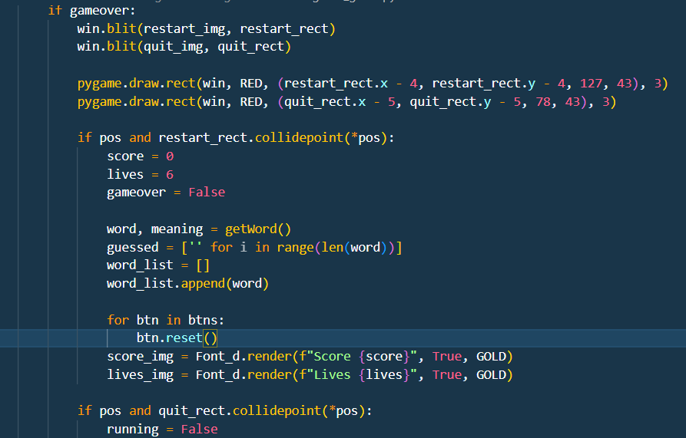

Slide 12
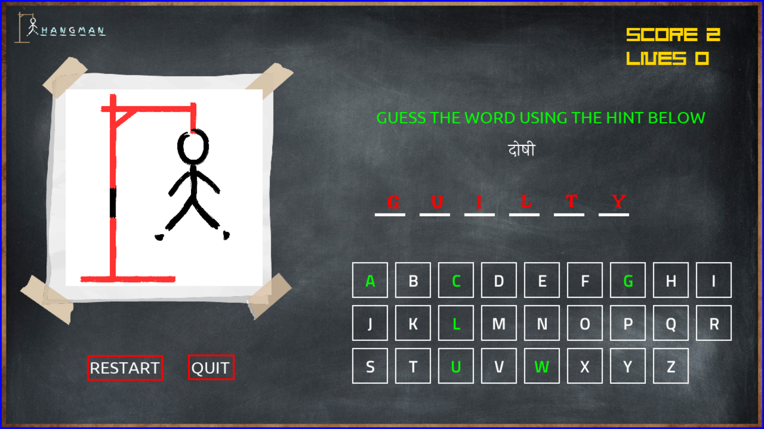

Slide 13
Upcoming 15 days status:
Creating more levels.
Displaying WIN or LOSE popups.
Working on button animations.
Working on more sound effects.

Slide 14
THANK YOU

